Slide 1
Enabling Executive UC&C
November 13 2018
Austin TX

Slide 2

About Me
Shawn Weisfeld
Cloud Solution Architect
Microsoft – One Commercial Partner Technical Team
sweisfel@microsoft.com
Austin, TX

Slide 3
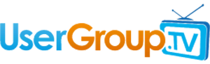
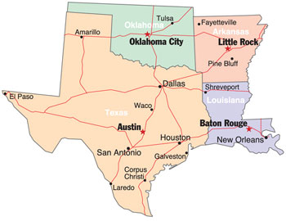
UserGroup.tv your source for FREE videos of technical community content online.
900+ hours of content donated by our local User Group speakers.
Check it out today @
http://www.UserGroup.tv
Interested in attending other regional events?
Check out what is going on in the Texas, Oklahoma, Louisiana and Arkansas Region.
https://SouthCentralCommunity.com

Slide 4
Automating and Managing Costs in Azure
Shawn Weisfeld
Cloud Solution Architect
Microsoft

Slide 5
Agenda
DevOps & Automation
Cost Management

Slide 6
Automation Tools
Portal
PowerShell
Cross Platform CLI
ARM Templates

Slide 7

WHAT IS DEVOPS?
It’s a job title
It’s automation
It’s Development and Operations collaboration
It means faster and smaller releases

Slide 8


Slide 9
What is DevOps?
People. Process. Products.
Build& Test
Deploy
DevOps is the union of people, process, and products to enable continuous delivery of value to your end users.
“
Continuous Delivery
Develop
Operate
”
Plan & Track
Monitor & Learn

Slide 10
How Microsoft can help
Microsoft Azure is a powerful and flexible foundation for past, present, and future apps – easily build, manage, and deploy any application and any stack on a massive, global network using your favorite tools and frameworks.
Flexible
Powerful
Open
Choice of IaaS, PaaS, public cloud or hybrid.
Mirror or modernize app infrastructure with VMs, containers, microservices or serverless.
Supports all stages of the app modernization journey – from lift-and-shift to Cloud-Native.
Instantly improve the performance, scalability and resiliency of your apps by moving them to the cloud.
Increase business agility with Cloud-Native capabilities and built-in DevOps for continuous innovation.
Bring your stack, we bring a cloud that runs any app, on any platform, and any language.
Build applications using the language and tools of your choice - Azure supports what you already use and love so you can get up and running fast – just bring code.

Slide 11
What technologies do I need to support DevOps?
DevOps brings together people, processes, and products, automating software delivery to provide continuous value to your users. Using Azure DevOps, you can deliver software faster and more reliably - no matter how big your IT department or what tools you’re using.
Continuous integration (CI)
Improve software development quality and speed.
When you use Azure Pipeliens or Jenkins to build apps in the cloud and deploy to Azure, each time you commit code, it’s automatically built and tested and bugs are detected faster.
Continuous Deployment (CD)
By combining continuous integration and infrastructure as code (IaC), you’ll achieve identical deployments and the confidence to deploy to production at any time.
With continuous deployment, you can automate the entire process from code commit to production if your CI/CD tests are successful.
Continuous Learning & Monitoring
With Azure Application Insights you can identify how your applications are performing and test if the recent deployment made things better or worse.
Using CI/CD practices, paired with monitoring tools, you’ll be able to safely deliver features to your customers as soon as they’re ready.

Slide 12





Introducing Azure DevOps
Azure Boards
Azure Pipelines
Azure Repos
Deliver value to your users faster using proven agile tools to plan, track, and discuss work across your teams.
Build, test, and deploy with CI/CD that works with any language, platform, and cloud. Connect to GitHub or any other Git provider and deploy continuously.
Get unlimited, cloud-hosted private Git repos and collaborate to build better code with pull requests and advanced file management.
Azure Test Plans
Azure Artifacts
➔
Test and ship with confidence using manual and exploratory testing tools.
Create, host, and share packages with your team, and add artifacts to your CI/CD pipelines with a single click.
https://azure.com/devops

Slide 13



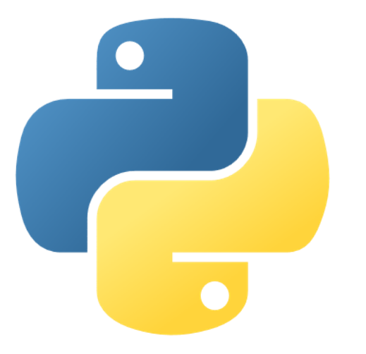








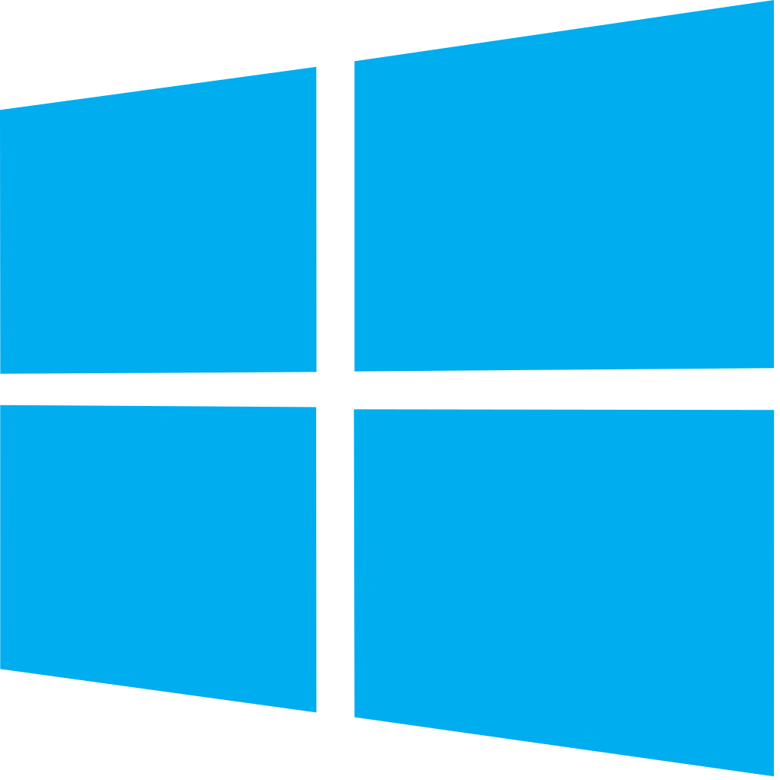


Azure DevOps: Choose what you love
Any Language, Any Platform
Azure DevOps lets developers choose the tools and languages that are right for them
Mix and match to create workflows with tools from Microsoft, open source or your favorite 3rd party tools
Target any cloud, on-prem or both and deploy to the servers you need

Slide 14
Demo
Notes:
Demo : dev.azure.com

Slide 15

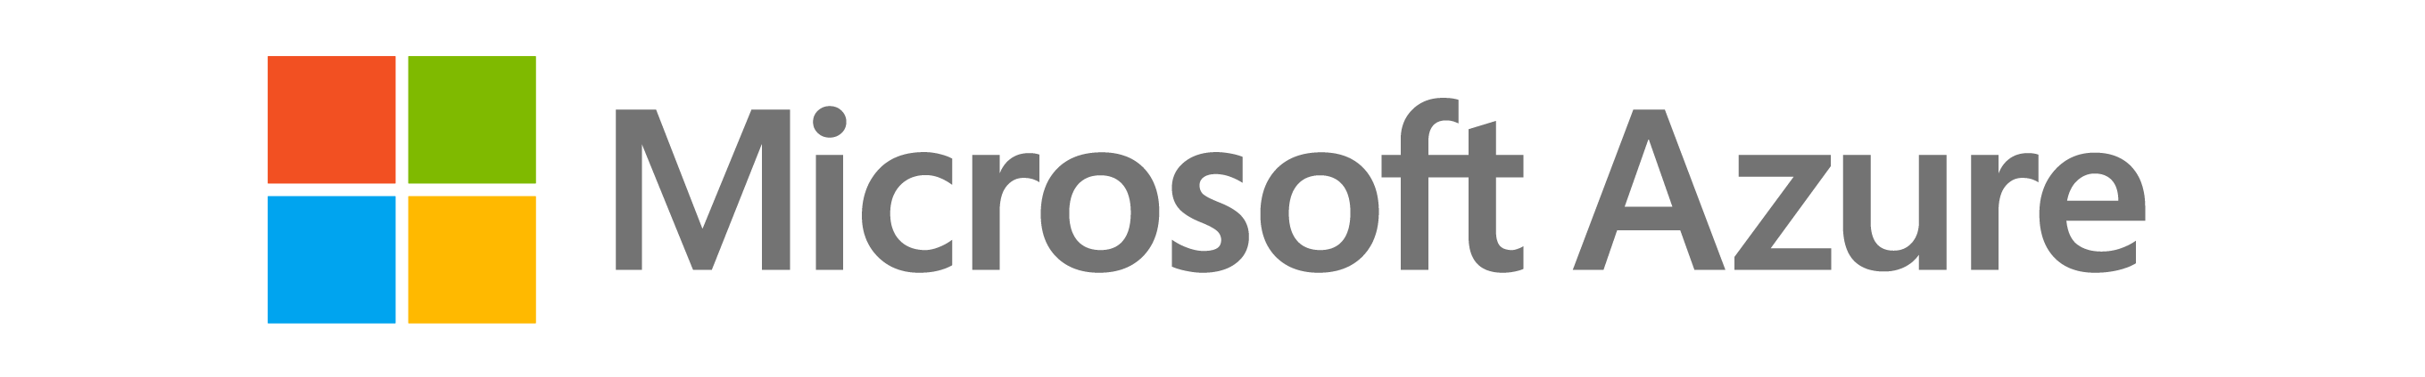

Today’s you are faced with a complex cloud environment
Running millions of cloud resources
In a multi-cloud environment
Across business units and projects

Slide 16



Complexity leads to several problems
Lack of visibility
Over spending
Need to do more
My cloud projects are distributed through multiple teams, how do I get visibility into my spending, budgets, etc?
We have a lot of resources in our environments, are we taking advantage of the cloud benefits and driving cost saving behavior?
I need to grow my business but I don’t have enough budget for all the projects I need!

Slide 17
Ways to optimize
Analyze
Save
Reinvest
Understand spending
License benefits and right size
New projects
Azure Cost Management
Azure Hybrid Benefit
Reserved Instances
Azure Advisor
Migrate
Modernize
Secure & Manage

Slide 18

Analyze
Azure provides you the tools that are needed to help analyze your spending
Azure Cost Management

Slide 19
Demo
Notes:
Demo : dev.azure.com

Slide 20

Save
Save by optimizing licensing and right-sizing
Reserved Instances
Azure Hybrid Benefit
Azure Advisor

Slide 21
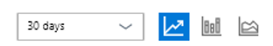
Reserved Instance
RI Break even vs. On Demand usage
1
Reserve virtual machines in advance
Cost simulation
2
Select 1 or 3-year terms with significant benefits
250k
200k
On-demand charges
Savings
Significant cost savings – up to 80% over pay-as-you-go models
150k
100k
Reservation charge
Budget predictability and prioritized compute capacity
6 months to break even
50k
Flexibility to modify reservations and simplicity of purchase
1 month
3 month
6 month
9 month
12 month

Slide 22
Azure Hybrid Benefit
Get base compute rates if you have active Software Assurance on your on-premise Windows Server licenses
$3.972/hour
Full cost
Base rate + SQL EE and Windows
~75% savings
~85% savings¹
~93% savings
$0.972/hour
Base rate + Windows
$0.598/hour
Base Rate
$0.28/hour
Base Rate
Not using Azure Hybrid Benefit
Azure Hybrid Benefit for SQL Server
Azure Hybrid Benefit for Windows and SQL Server
Azure Hybrid Benefit for Windows and SQL Server+3-year RI
¹Savings based on 8-Core D13 v2 VM in East US 2 region. Savings are calculated from full price (license included) for SQL Server Enterprise edition VM against reduced rate (applying Azure Hybrid Benefit for SQL Server and Windows Server), which excludes Software Assurance costs for SQL Server and Windows Server, which may vary based on EA agreement. Actual savings may vary based on region, instance size and compute family. Prices as of June 5 2018, subject to change.

Slide 23




Azure Advisor provides free and personalized right sizing recommendations
High Availability |  | Security |  | Performance |  | Cost
Improve the availability of your business-critical applications |  | Enhance protection of your Azure resources from potential security threats |  | Optimize performance to make the most of your resources |  | Maximize the return of your IT budget investment
Get your recommendations https://aka.ms/azureadvisor/

Slide 24

Reinvest
Reinvest savings into other projects to do more with your budget
Migrate
Modernize – Density, Containers, Serverless, etc.
Secure & Manage

Slide 25
Call to Action
Look to modern DevOps & Automation practices to streamline your application lifecycle.
Remember DevOps is a journey, find projects that can add value to the business and get better every day.
Optimize by
Analyze and understand what you are spending
Save by optimizing licensing and right-sizing
Reinvest savings into other projects to do more with your budget

